Slide 1
E-Learning Application

Slide 2
This project present in git repository in below URL
https://github.com/Kaleakash/e-learning-app.git
Plz login to virtual lab and clone this project in virtual lab using command as
git clone https://github.com/Kaleakash/e-learning-app.git

Slide 3
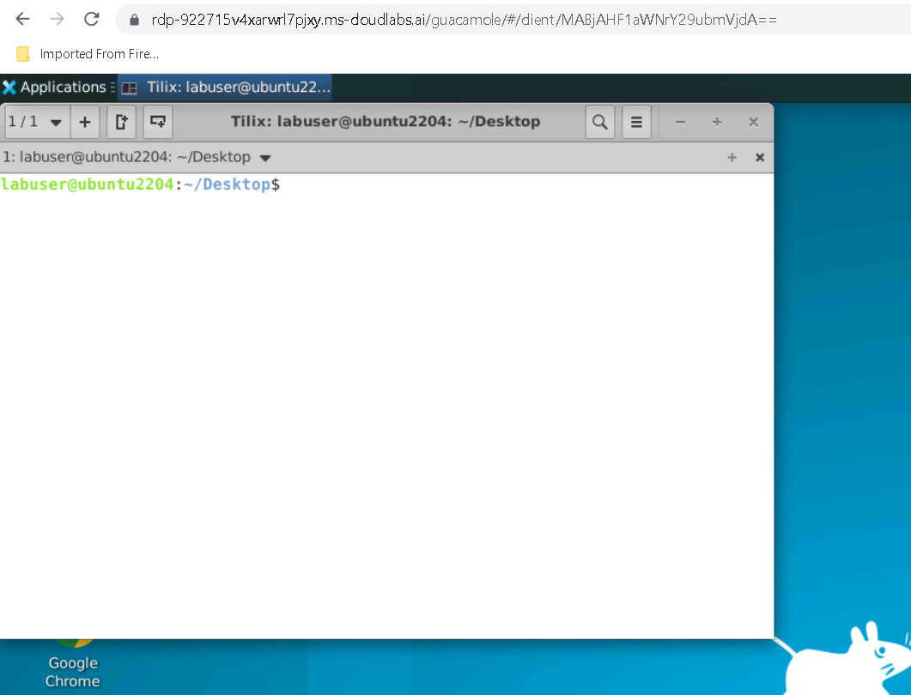

Slide 4
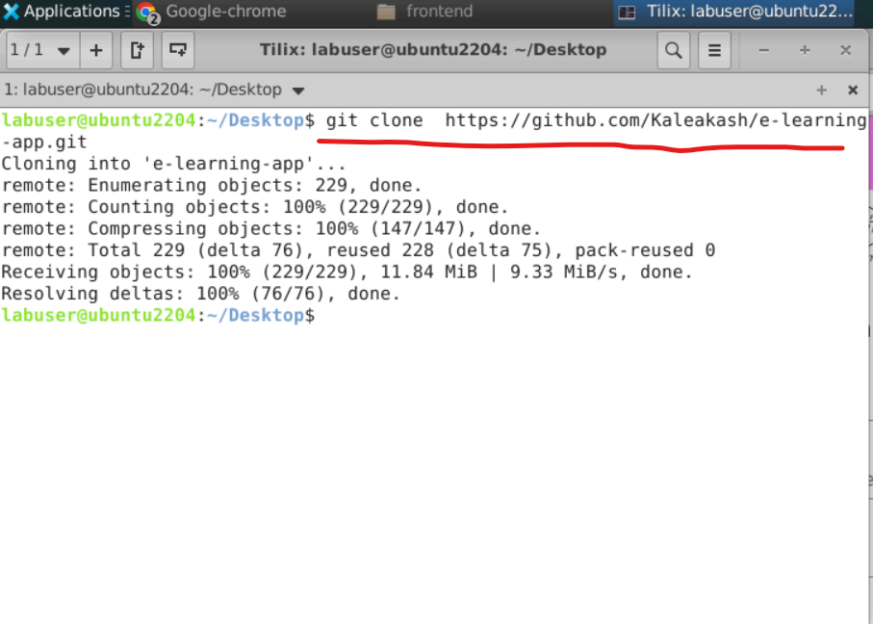

Slide 5
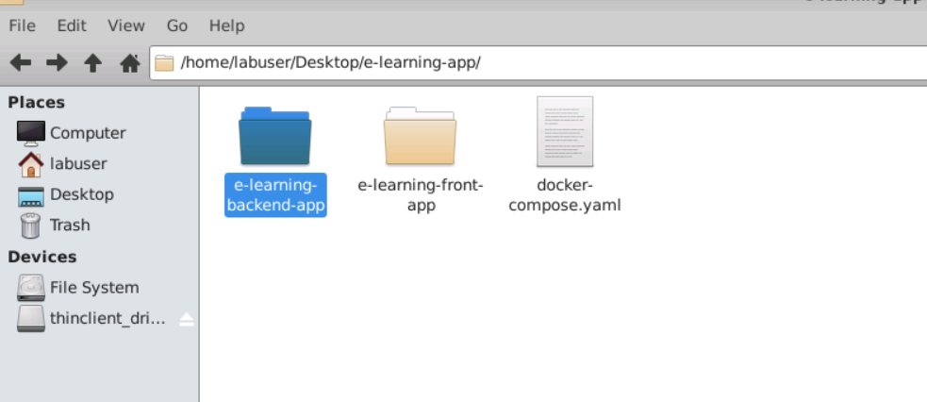
Project structure path

Slide 6
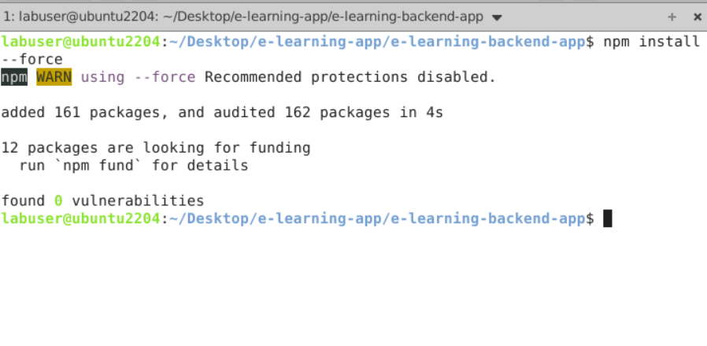
First move inside a e-learning-backend-app
Then run the command as npm install to install all required dependencies.

Slide 7
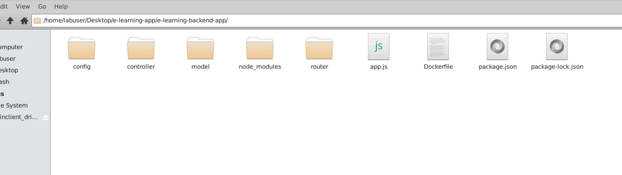
After updated you can see the structure of the project

Slide 8
Project structure explanation
Config : this folder contains database configuration details as well as initial set up for database. If we use local machine database then ip address must be local host or 127.0.0.1 with port number 27018.if we use Docker container then mongo db container name ie present in docker-compose.yml file as database.

Slide 9
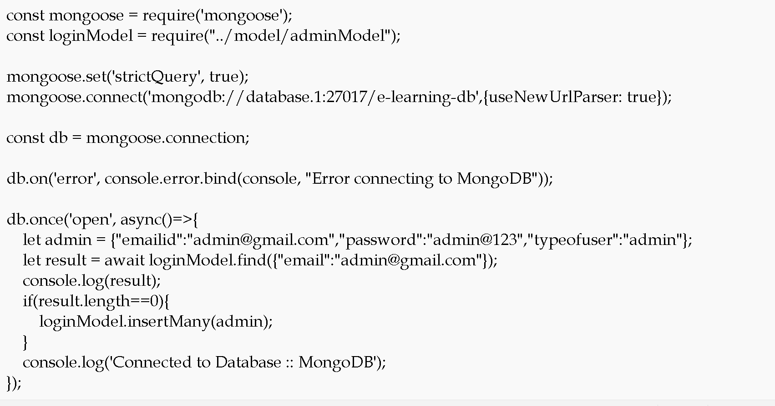

Slide 10
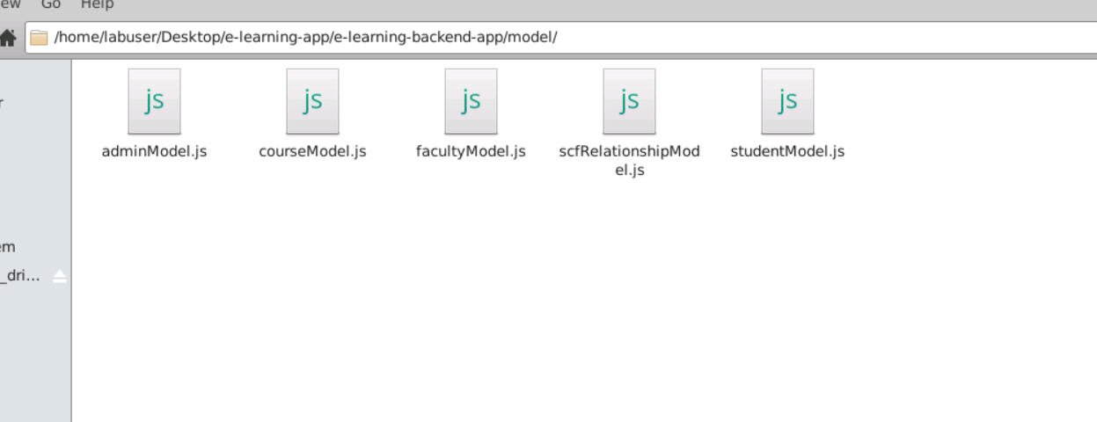
Model file: this file contains the structure of collection with schema definition

Slide 11
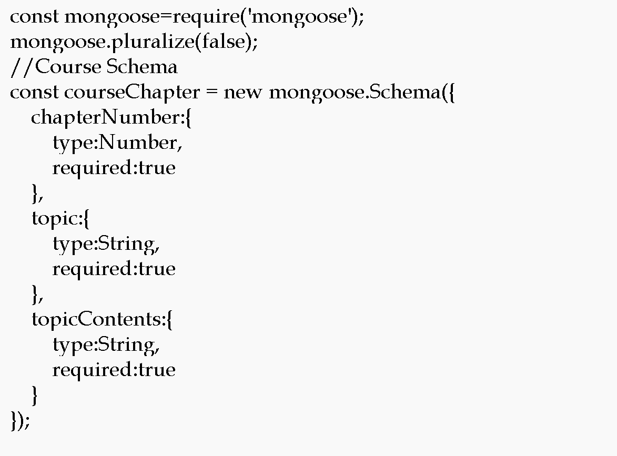

Slide 12
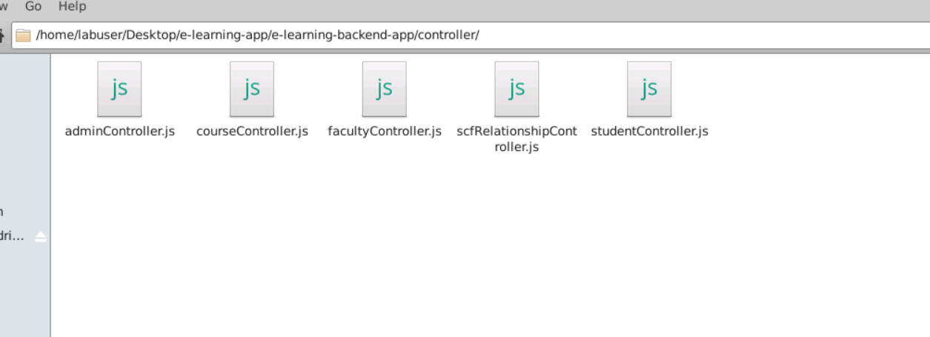
Controller file : which takes req and res and do the operation on model

Slide 13
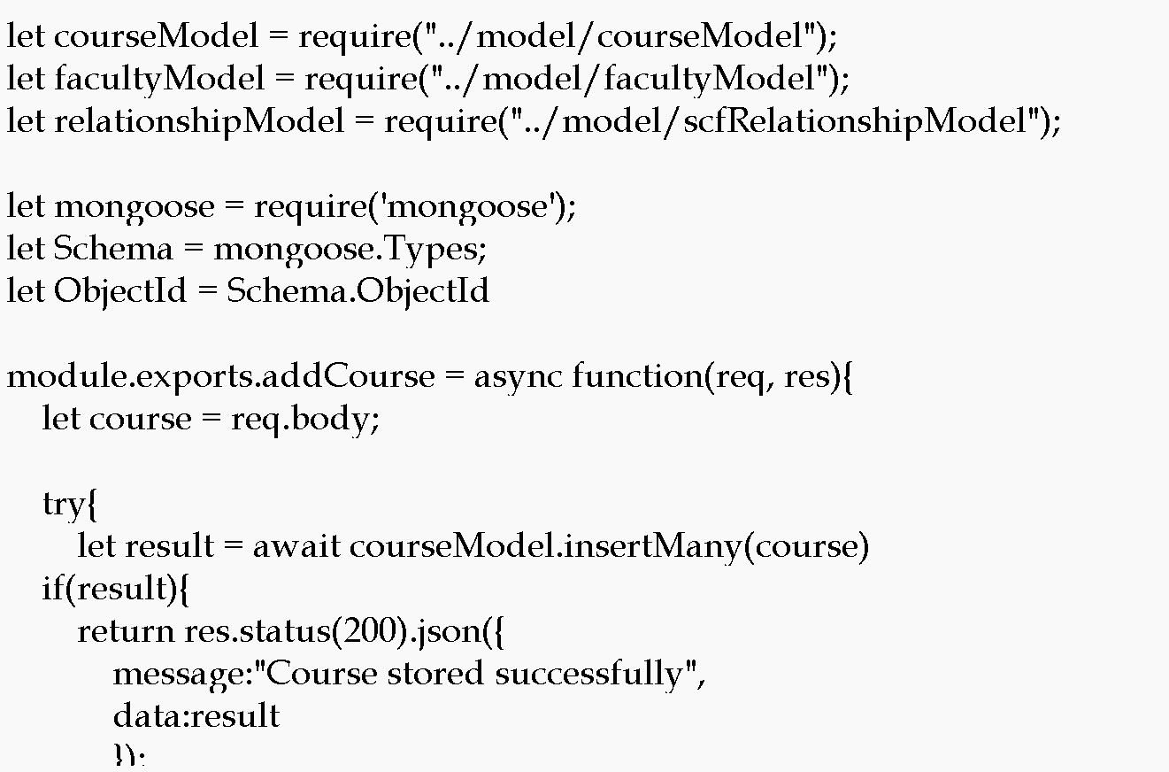

Slide 14
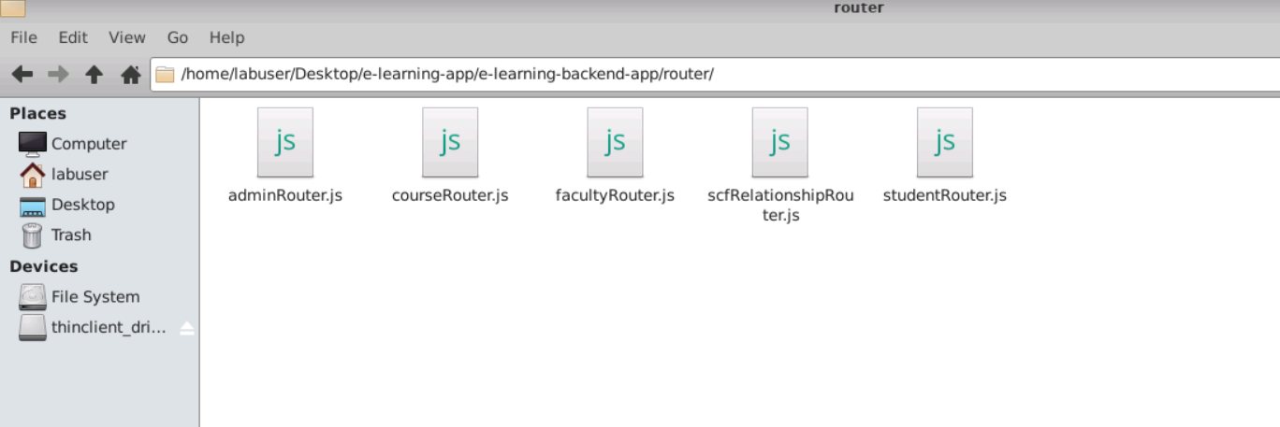
Router : it is use to map the request and http methods.

Slide 15
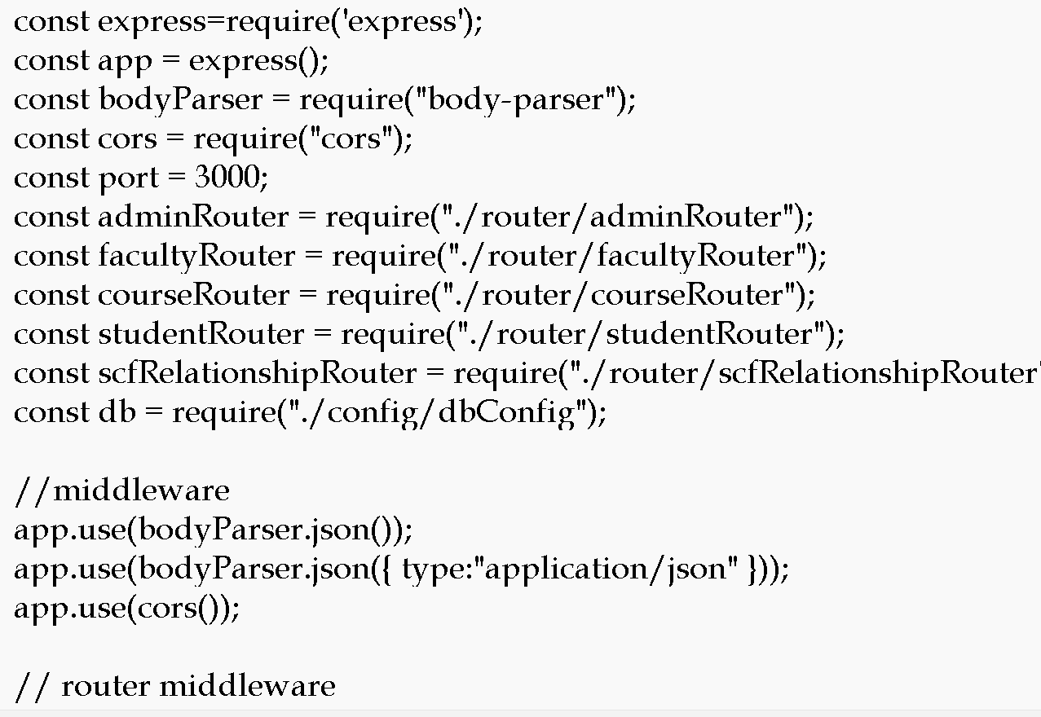
App.js : this is main file. Entry of the application

Slide 16
We will create Dockerfile
We are going to run the project using docker container so we need to create the Dockerfile.

Slide 17
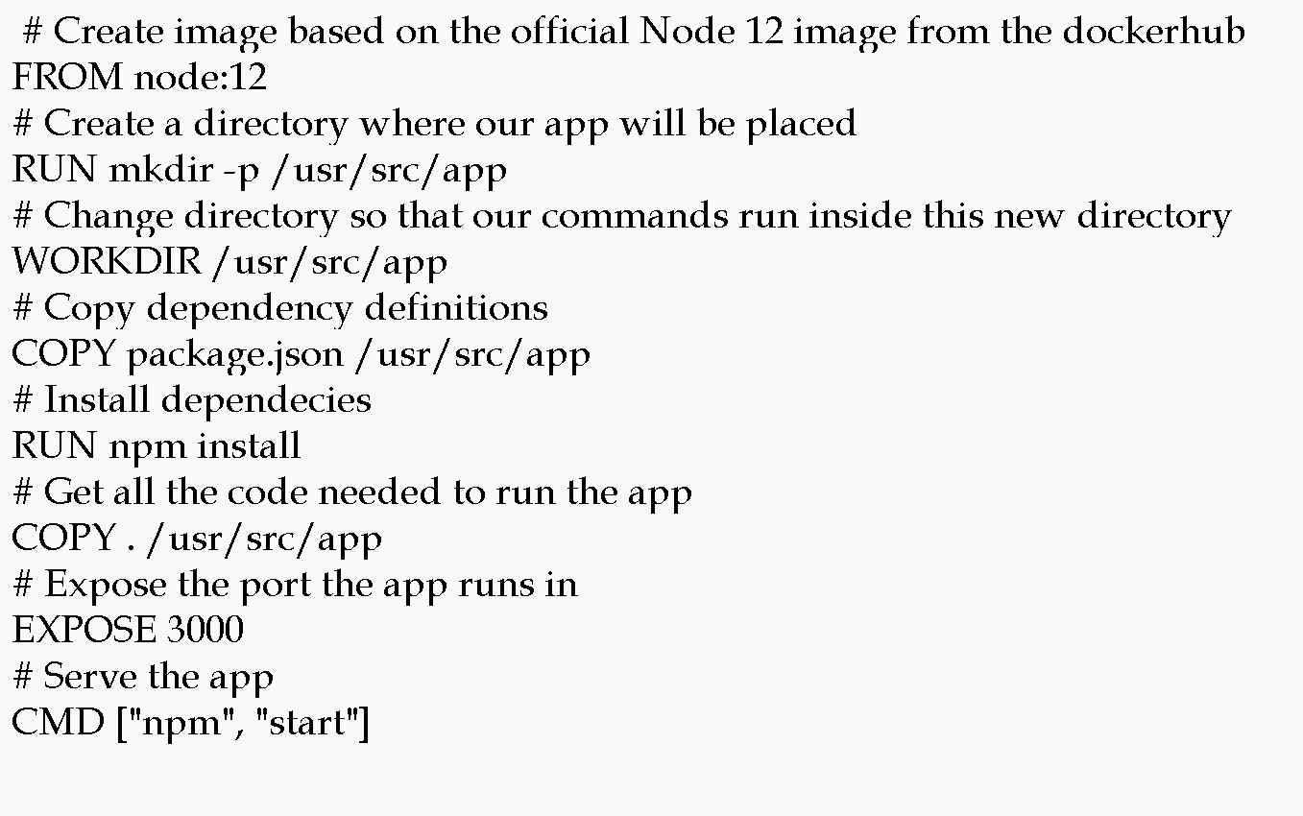

Slide 18
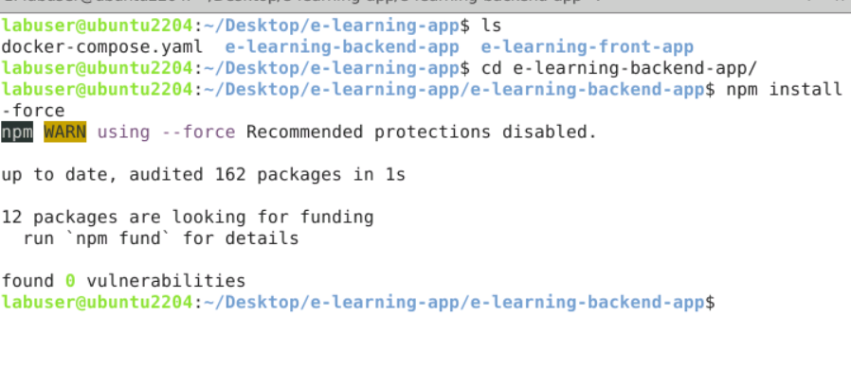
Now move inside a e-learning-front-app
Then run the command as npm install to install all required dependencies.

Slide 19
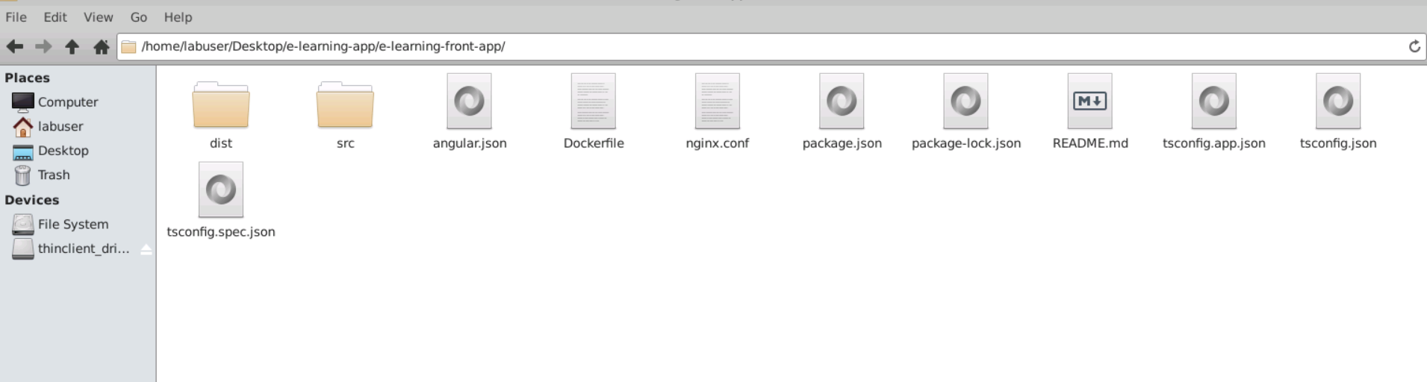
Front – angular project structure

Slide 20
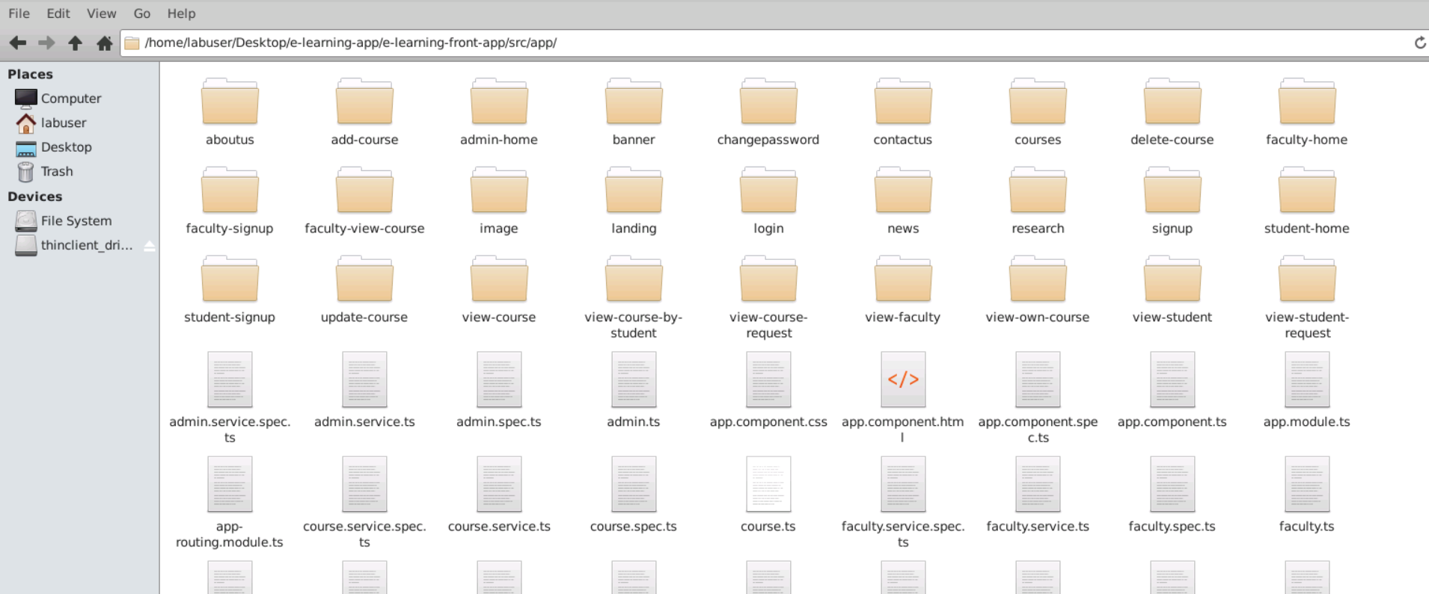
Project structure
Angular project contains lot of components, service as well as model classes .

Slide 21
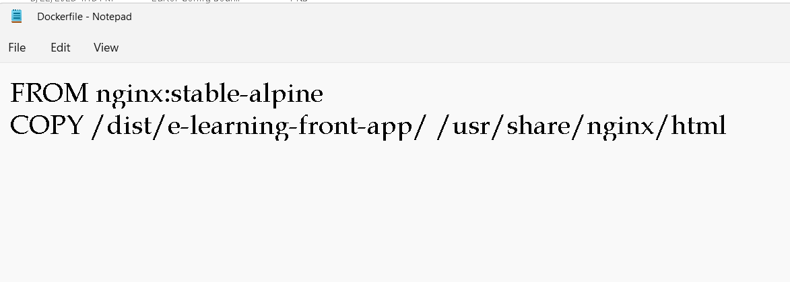
Now we will create the Dockerfile
We are going to run angular project using Dockerfile

Slide 22
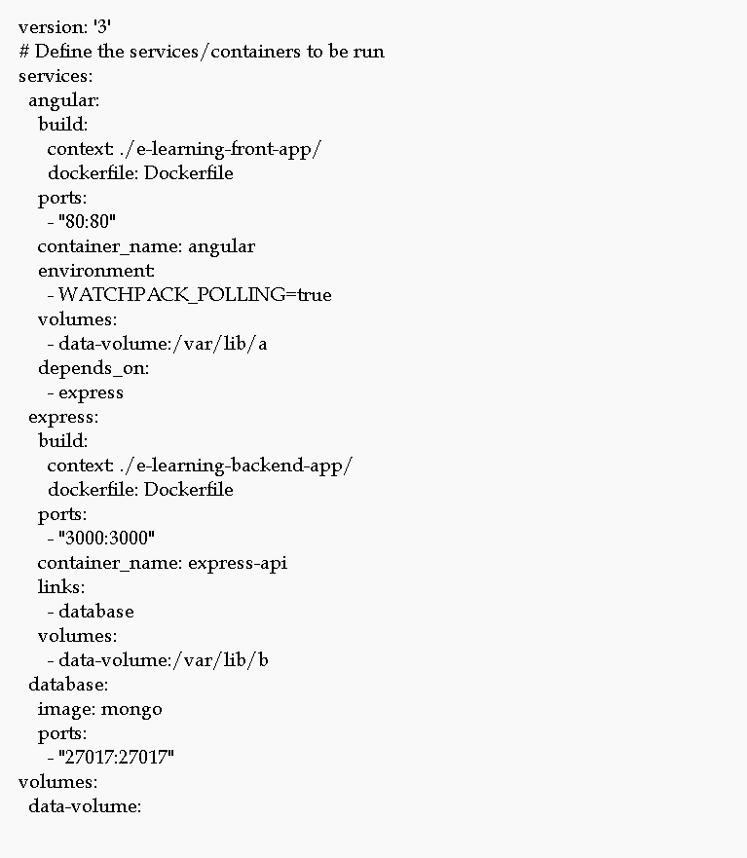
Now will create the docker-compose.yml

Slide 23
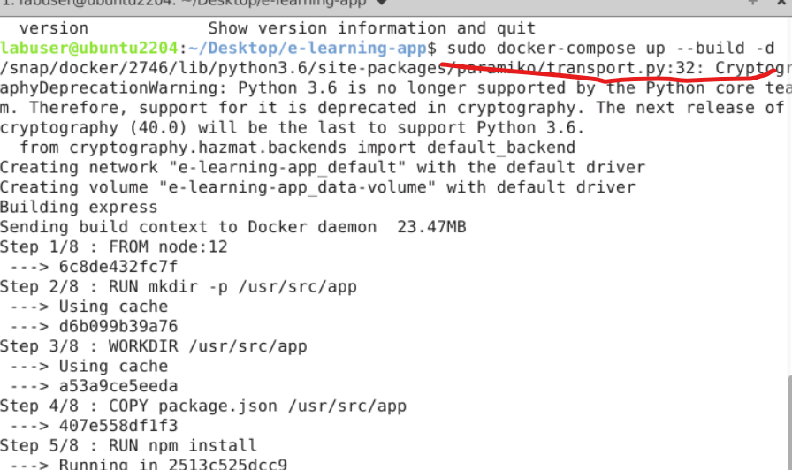
Now run the docker-compose file
sudo docker-compose up --build -d

Slide 24
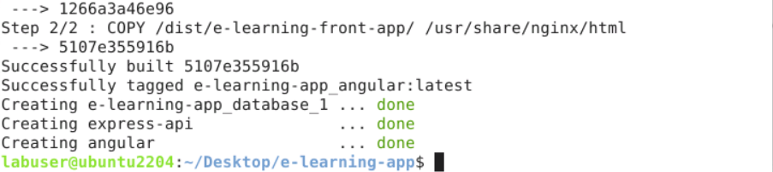
If everything go fine
Then three container get start.

Slide 25
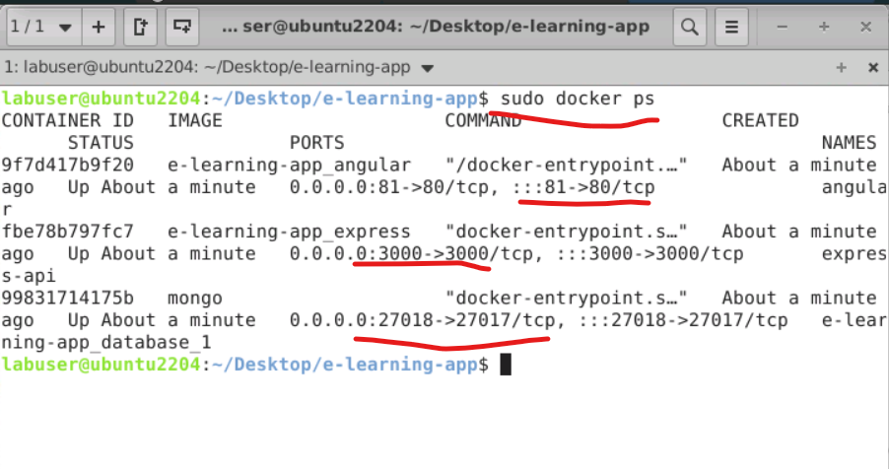
Check the container running details

Slide 26
Container details
Angular running with nginx server with 81 port number.
Express js running on port number 3000 port number
Mongo db database running on 27018 port number.

Slide 27
Now run the application using url as
http://localhost:81

Slide 28
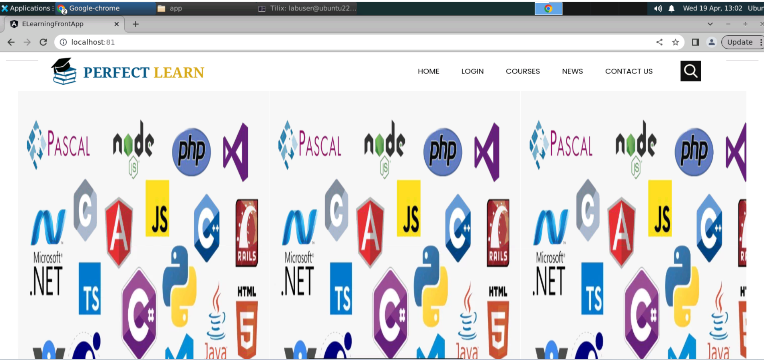

Slide 29
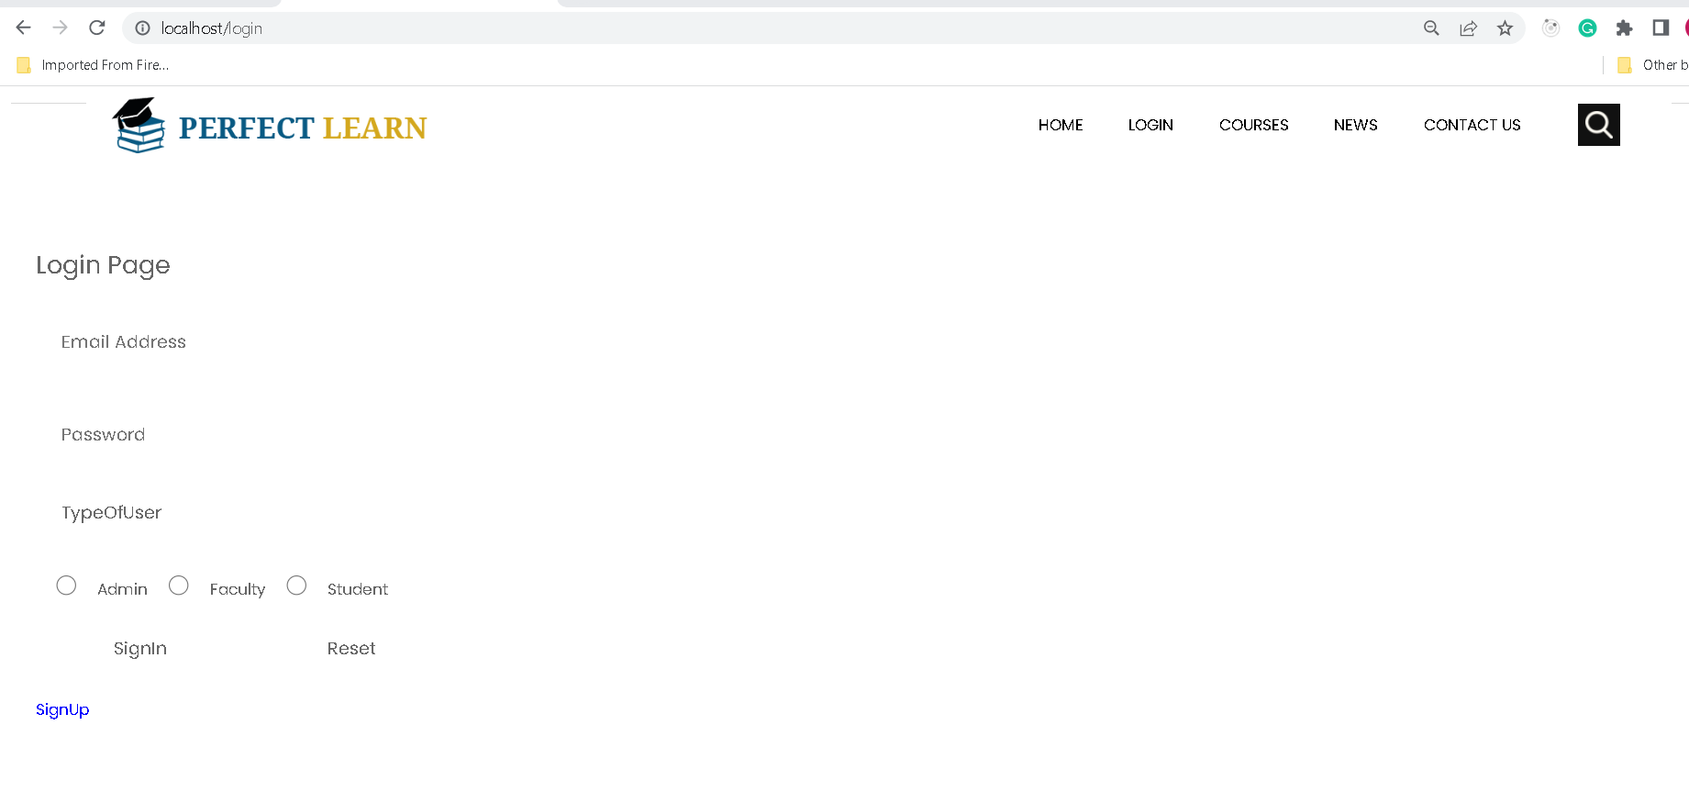
Login

Slide 30
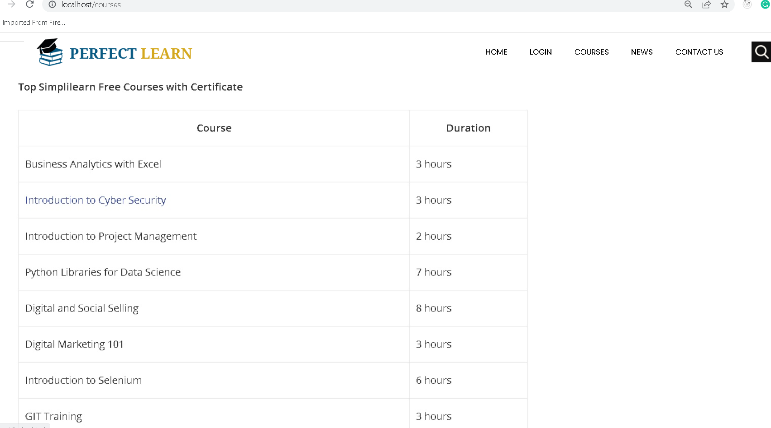
Courses

Slide 31
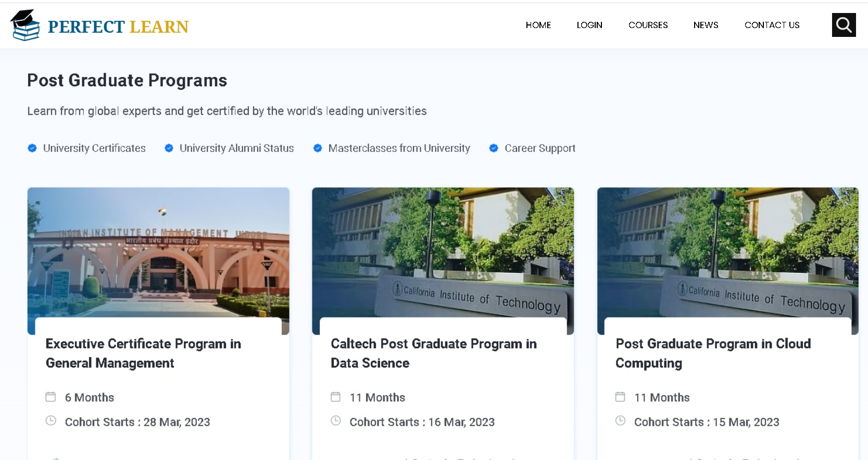
News

Slide 32
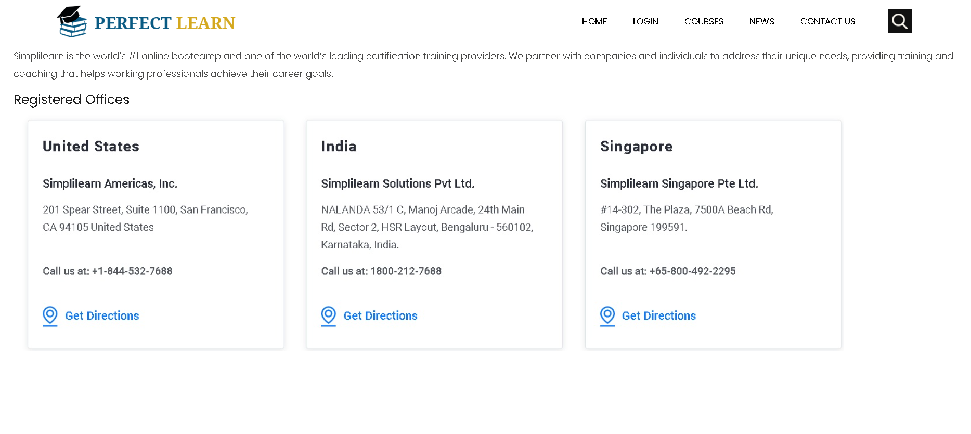
Contact us

Slide 33
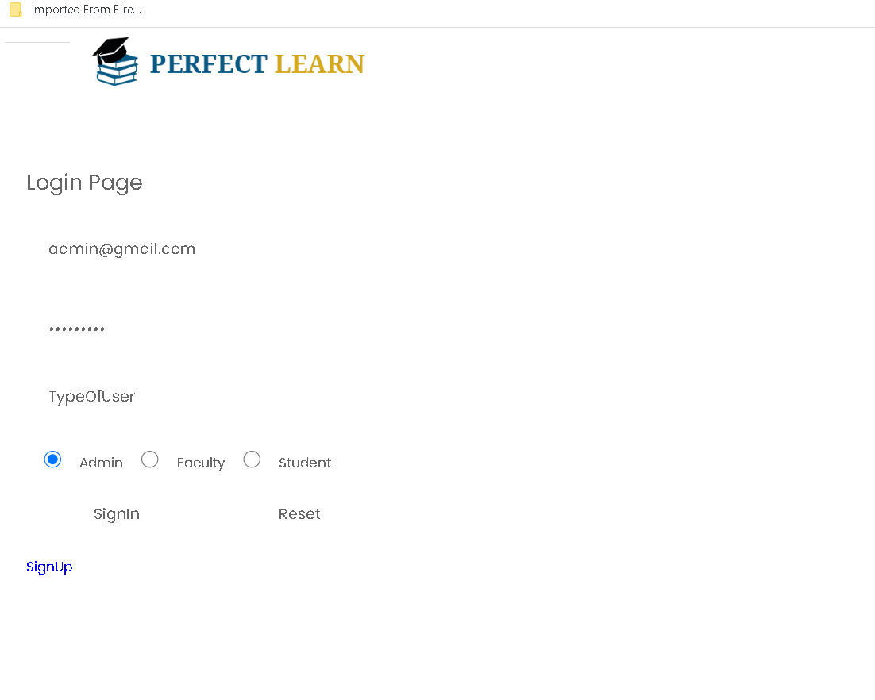
Admin login with emailid as admin@gmail.com and password as admin@123

Slide 34
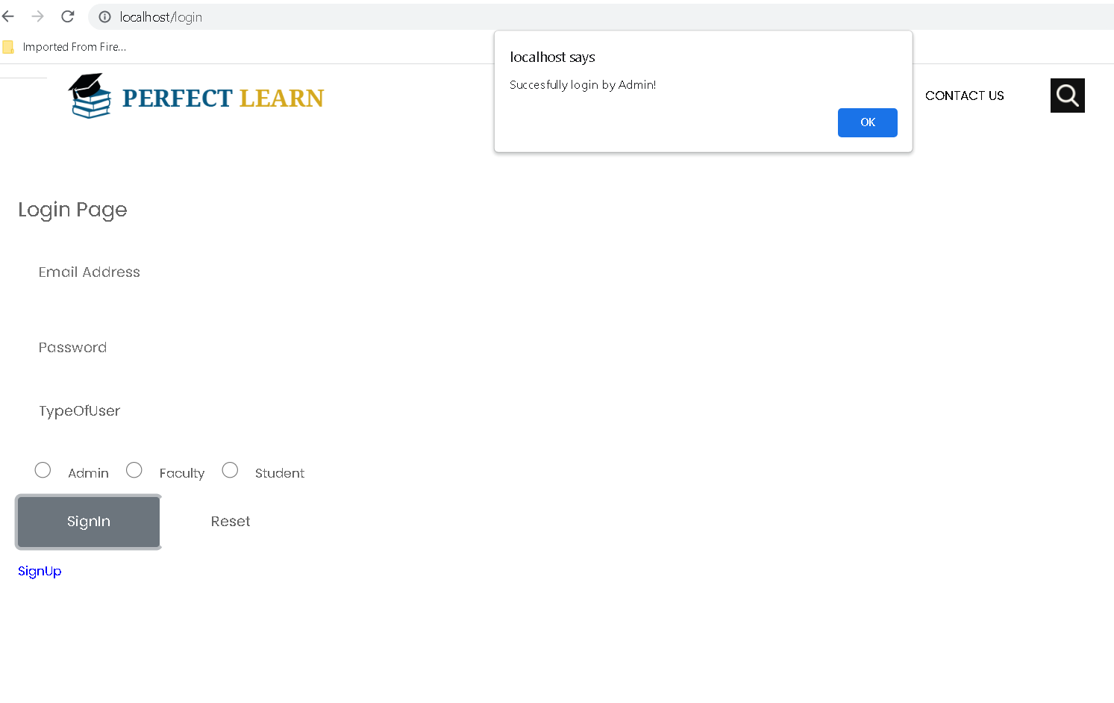
Admin successfully login

Slide 35
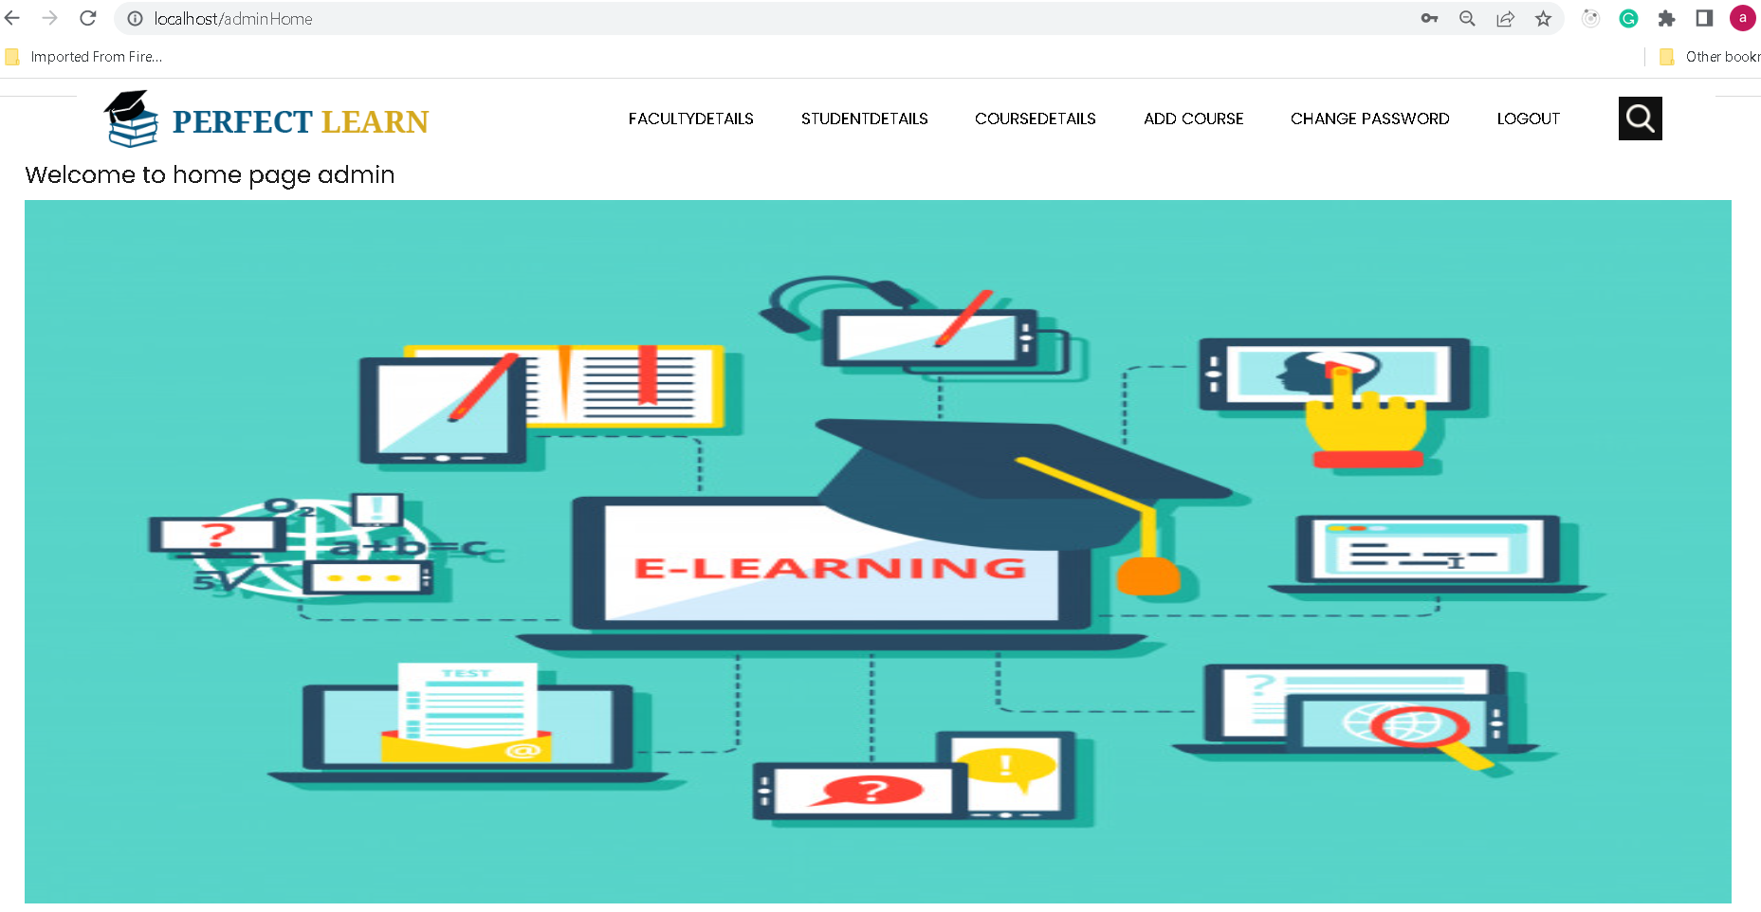
Admin home page

Slide 36
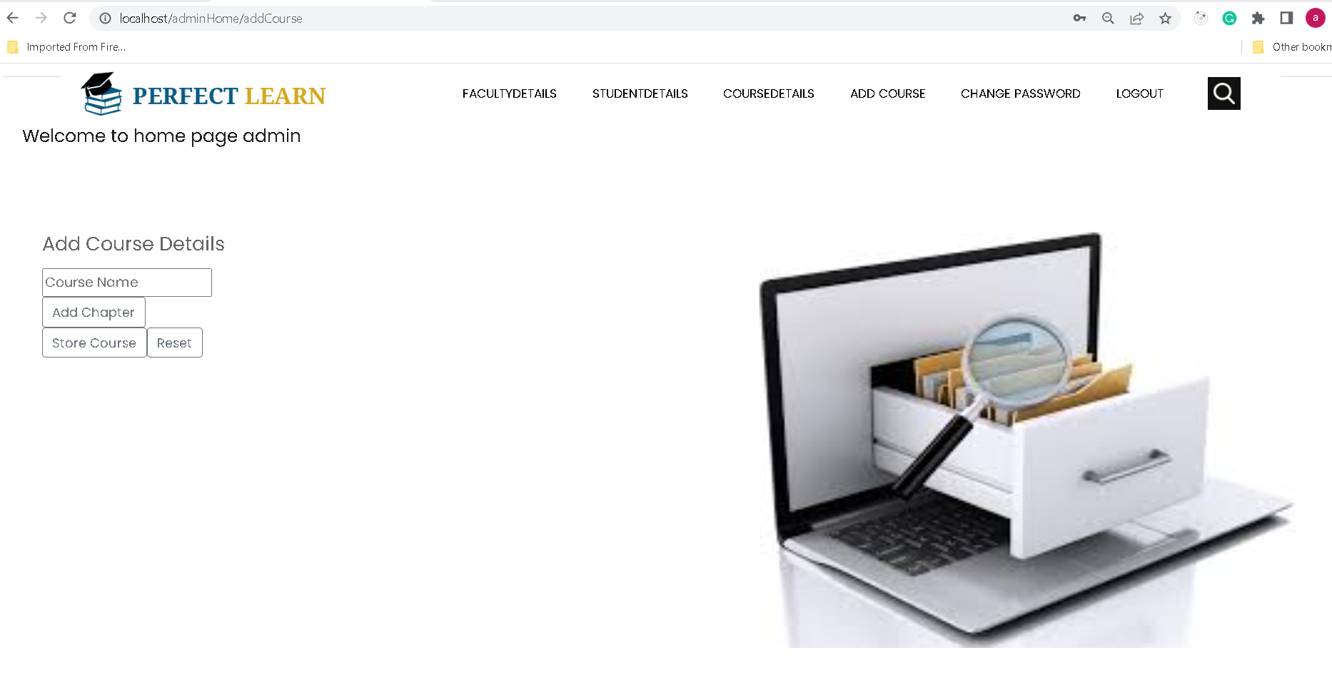
First we will add the course

Slide 37
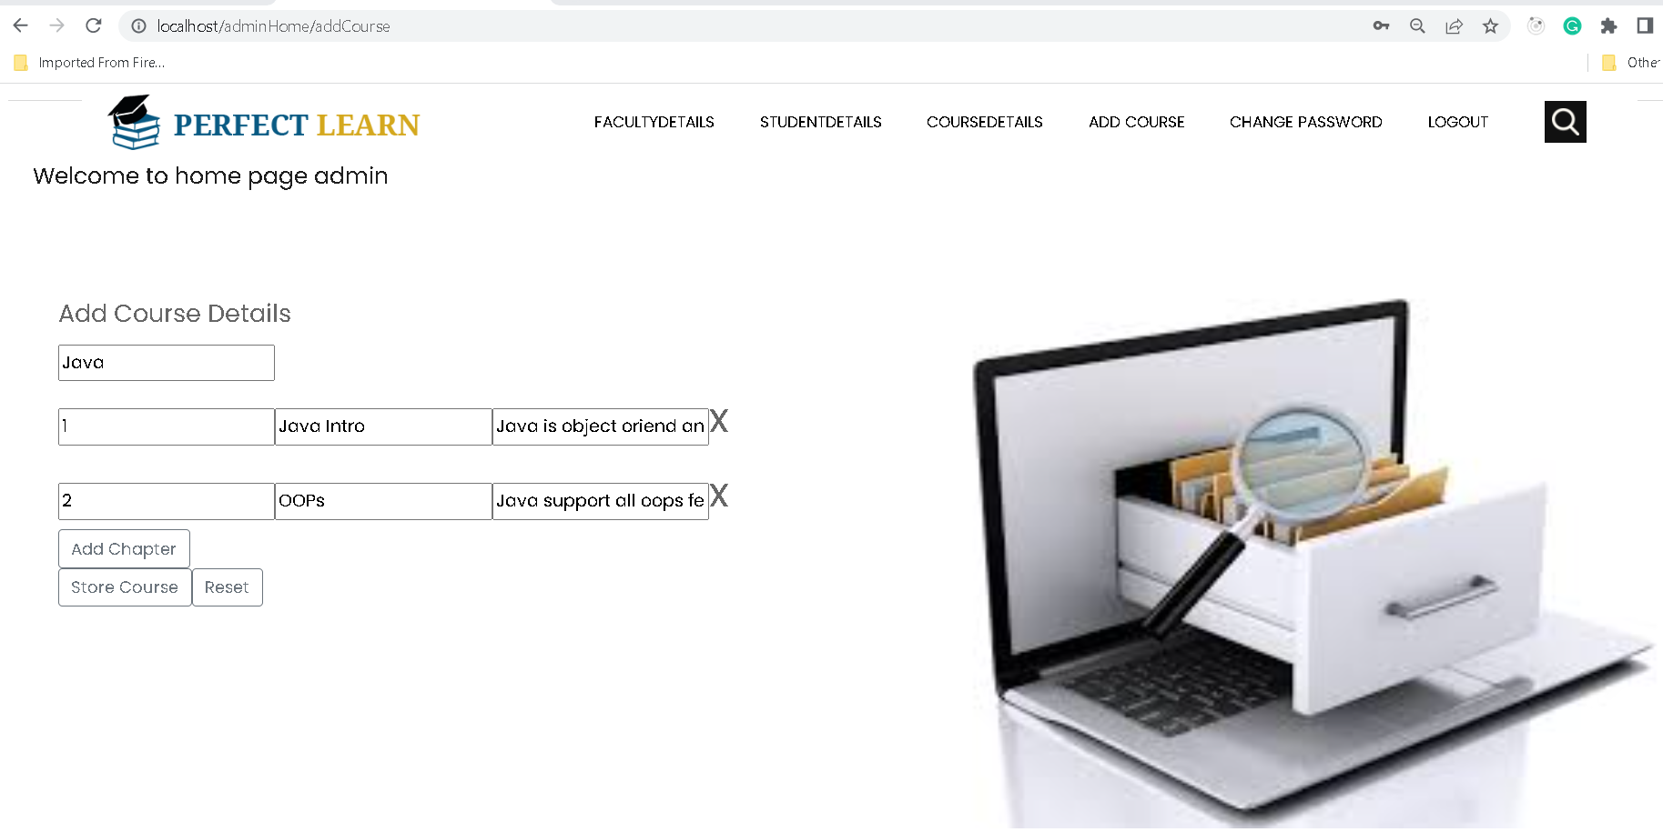
Continue…

Slide 38
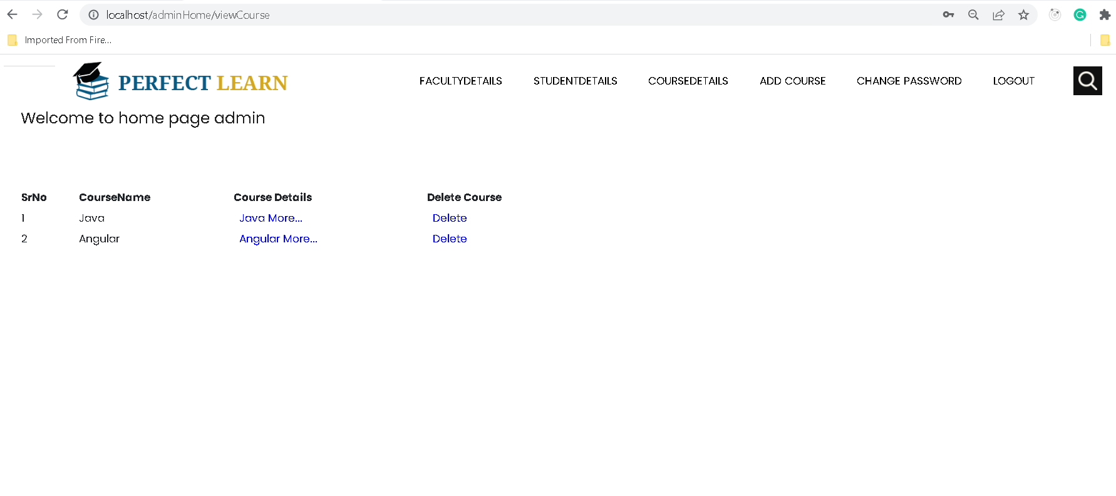
View added course and we can delete course also

Slide 39
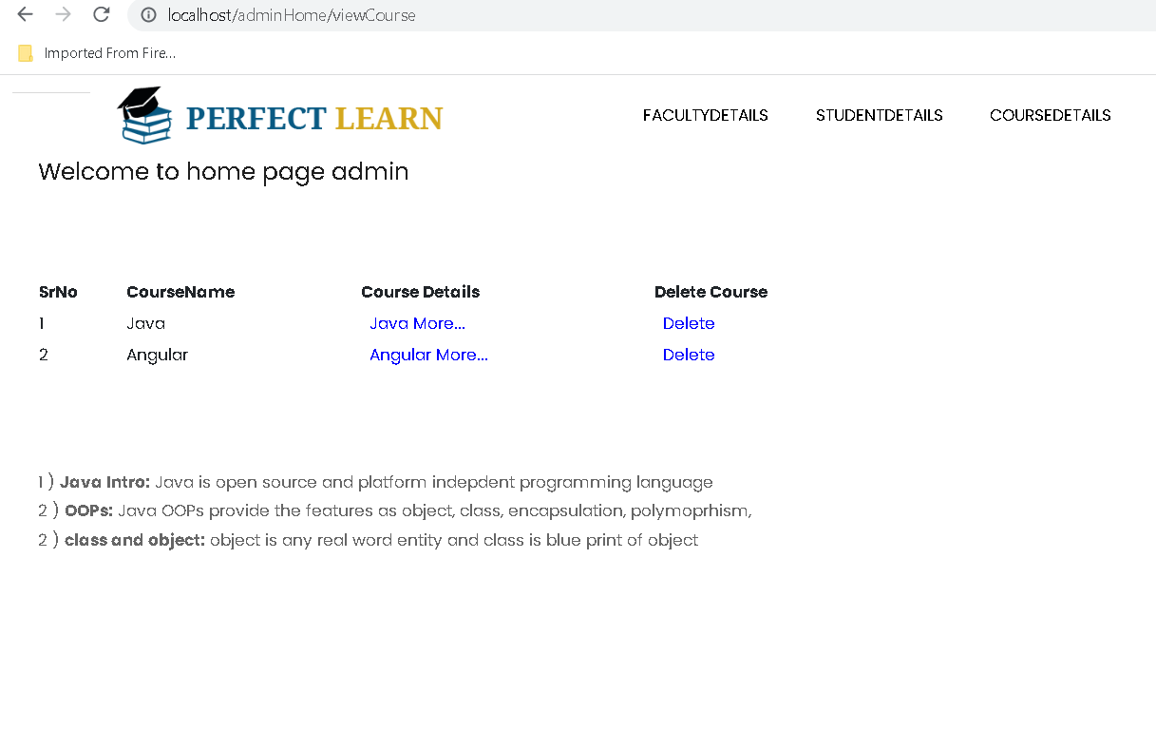
View the specific course details

Slide 40
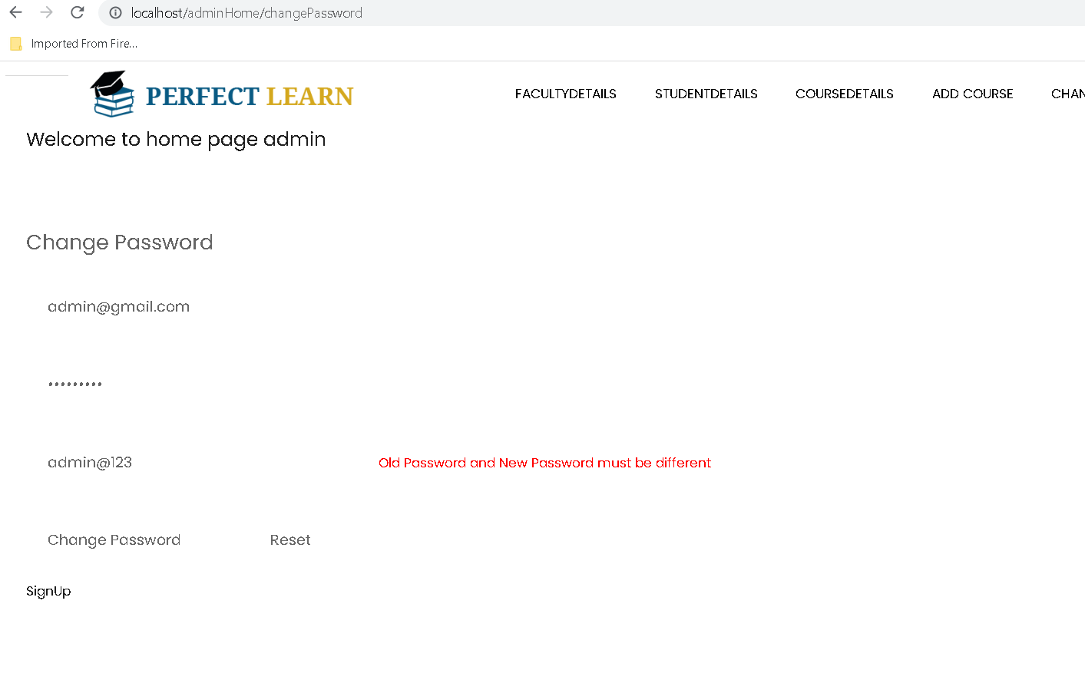
Change password

Slide 41
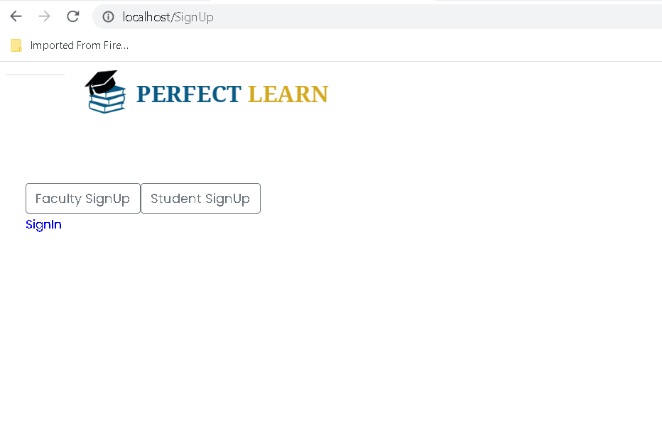
Now we will create faculty account

Slide 42
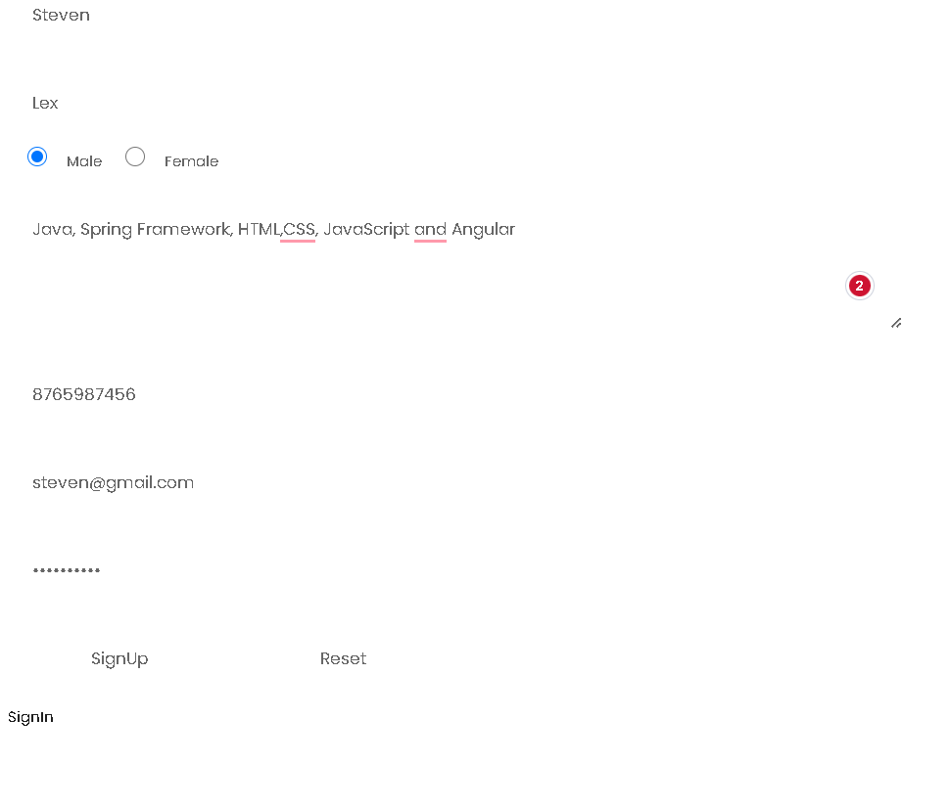
Signup for faculty account

Slide 43
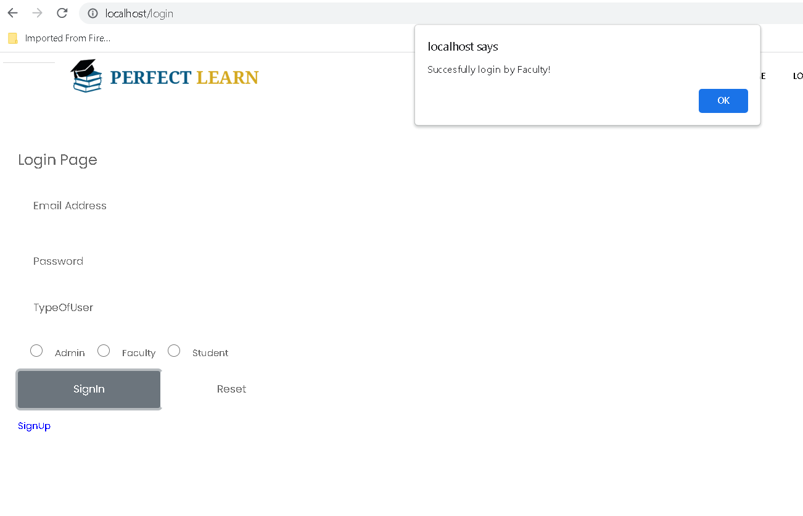
Faculty home page

Slide 44
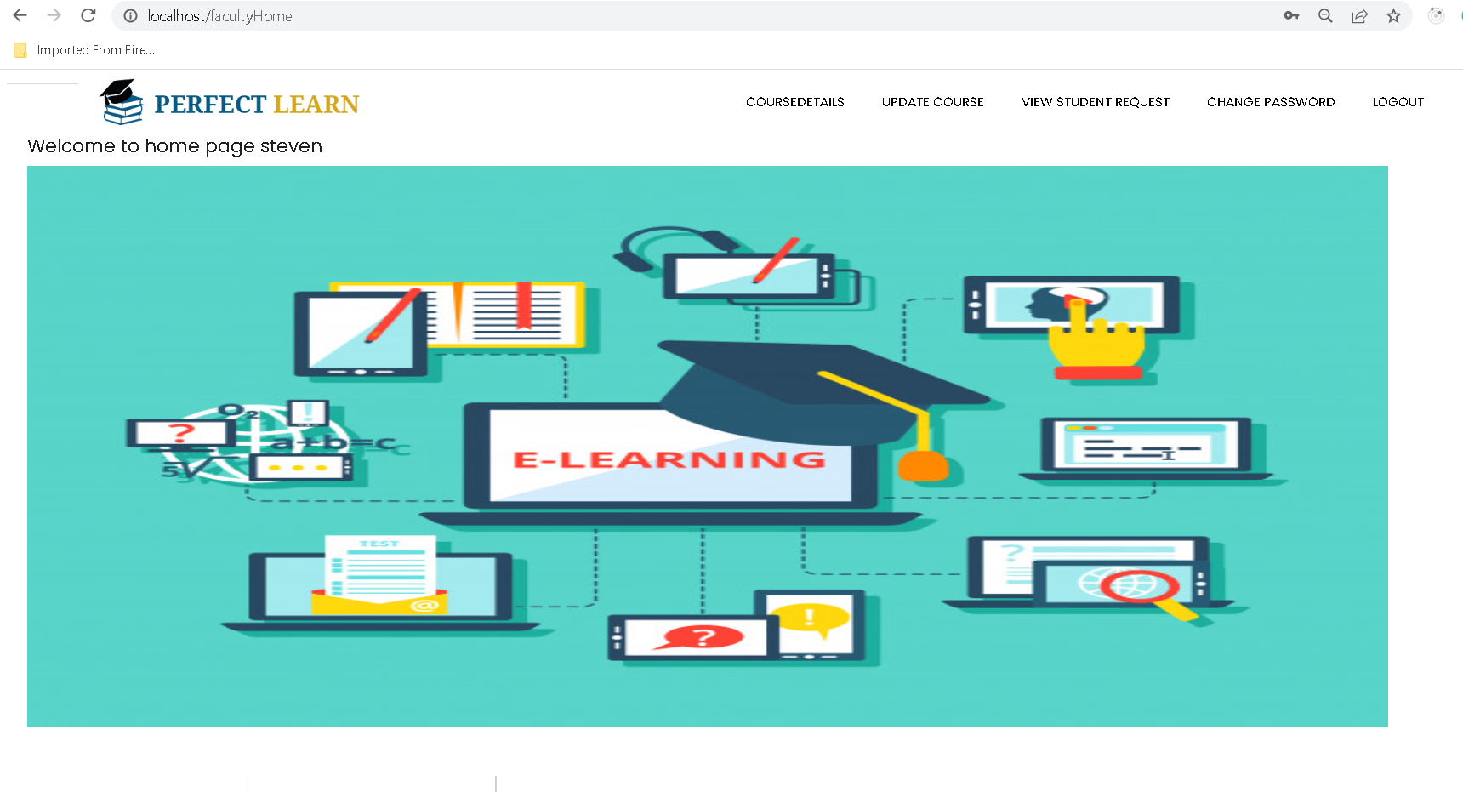
Faculty home page

Slide 45
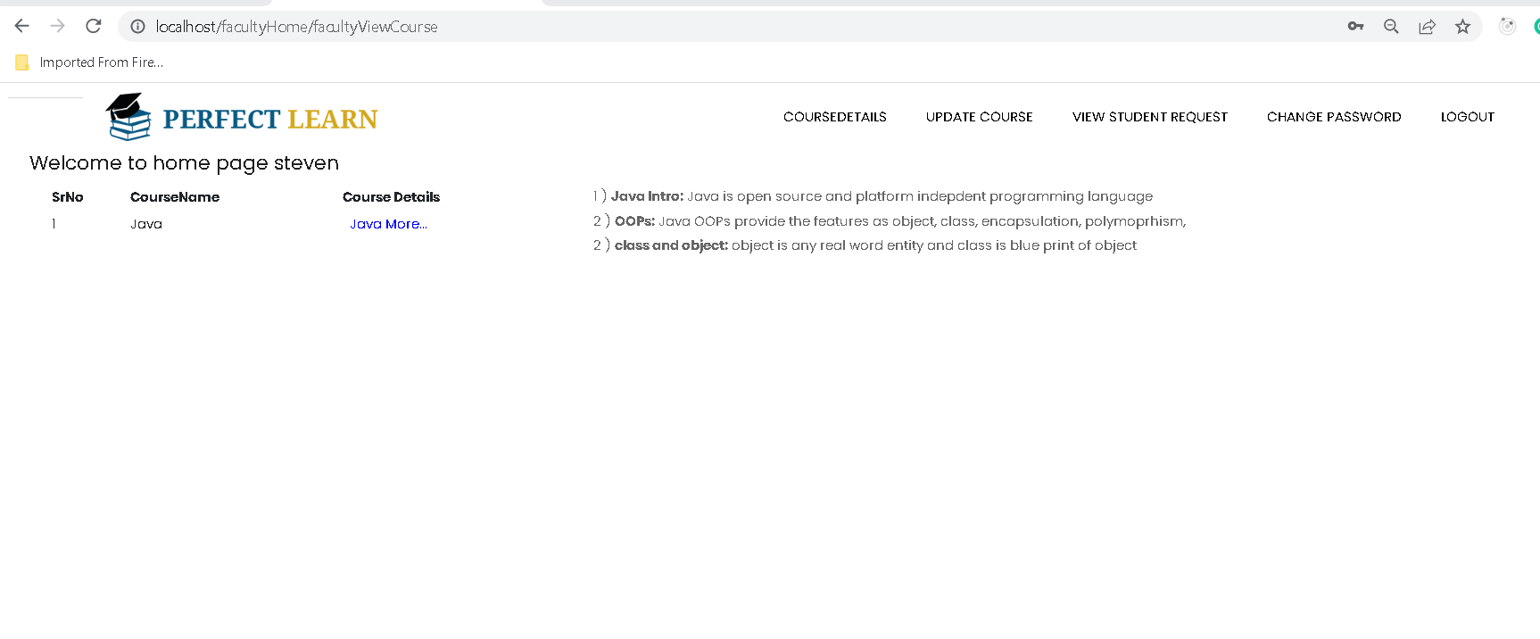
Course details

Slide 46
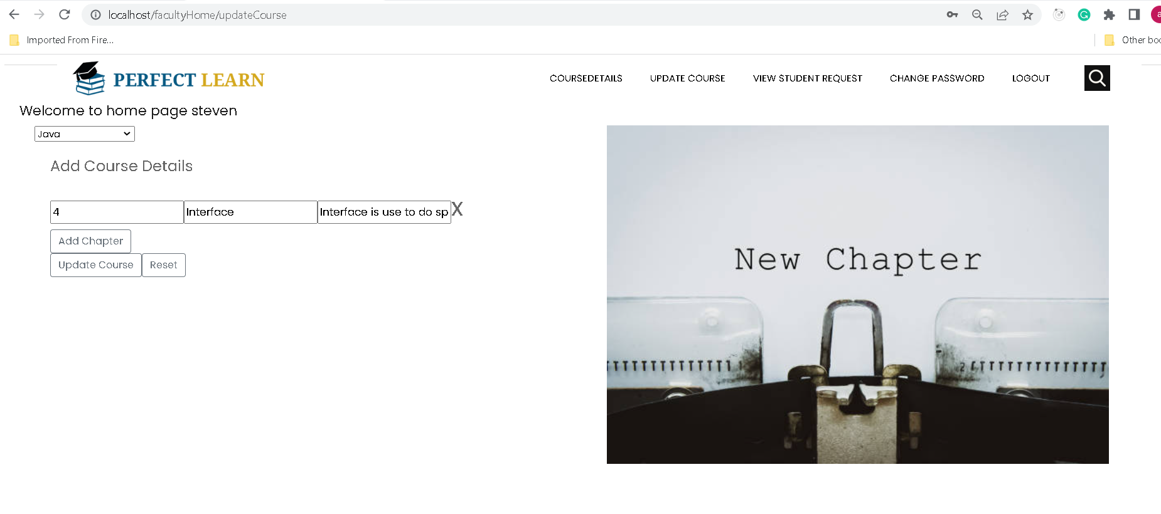
Update course

Slide 47
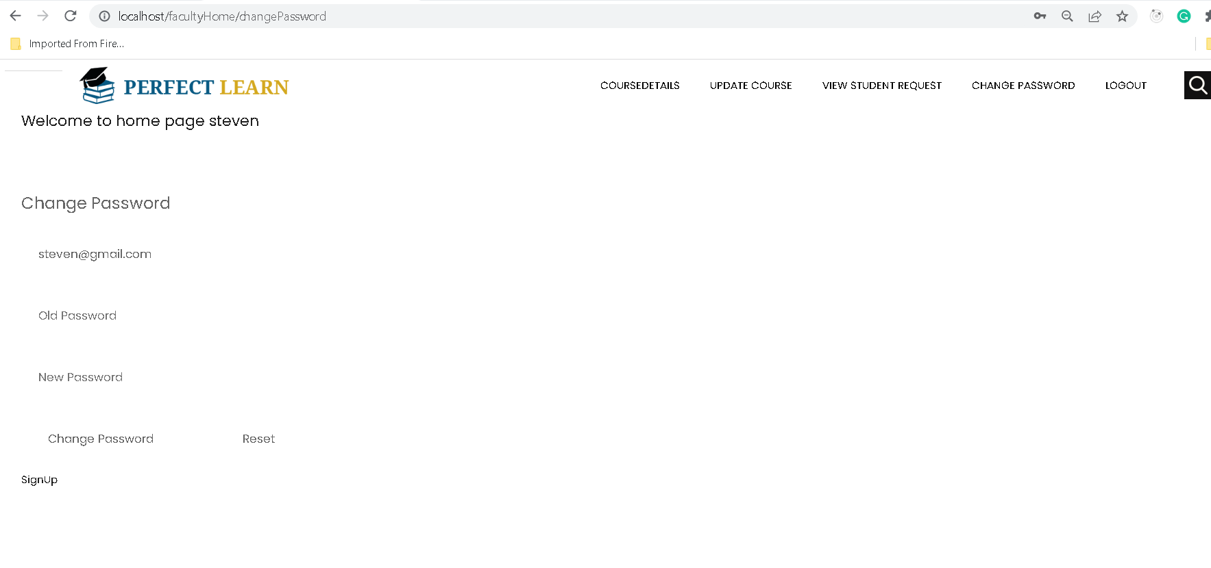
Faculty can change password

Slide 48
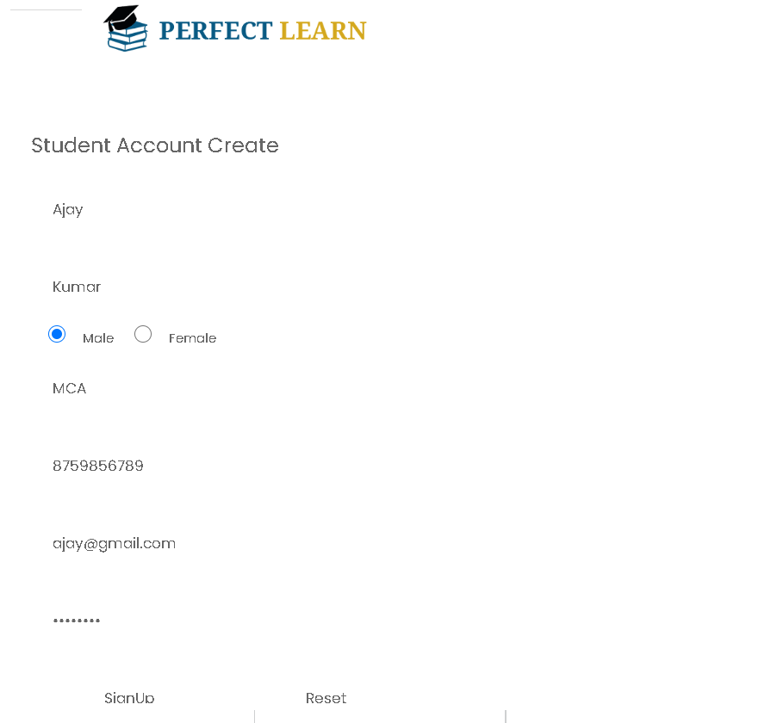
Student signup

Slide 49
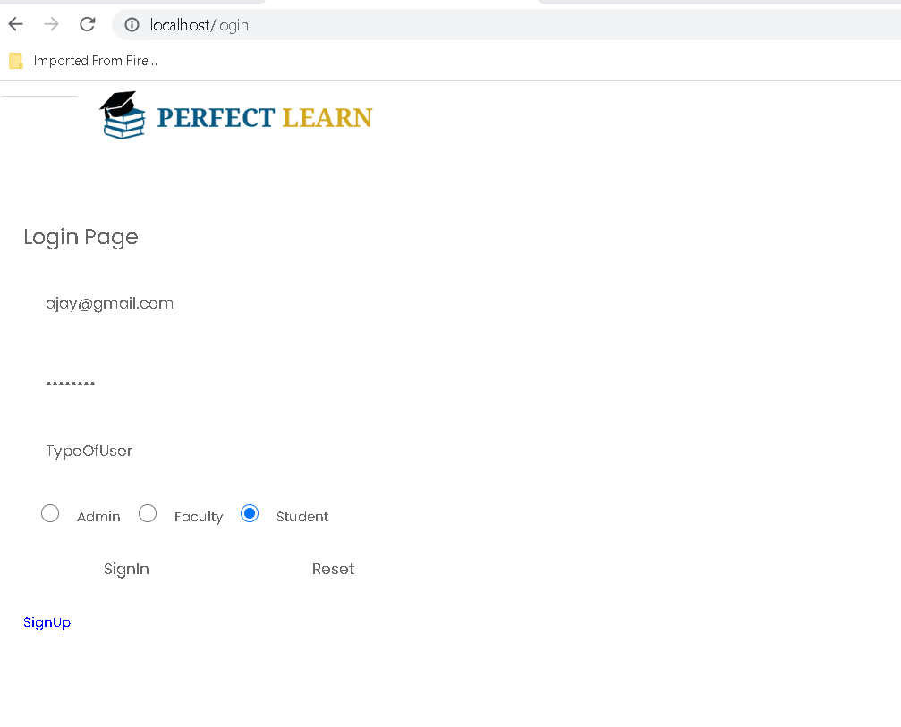
Student login

Slide 50
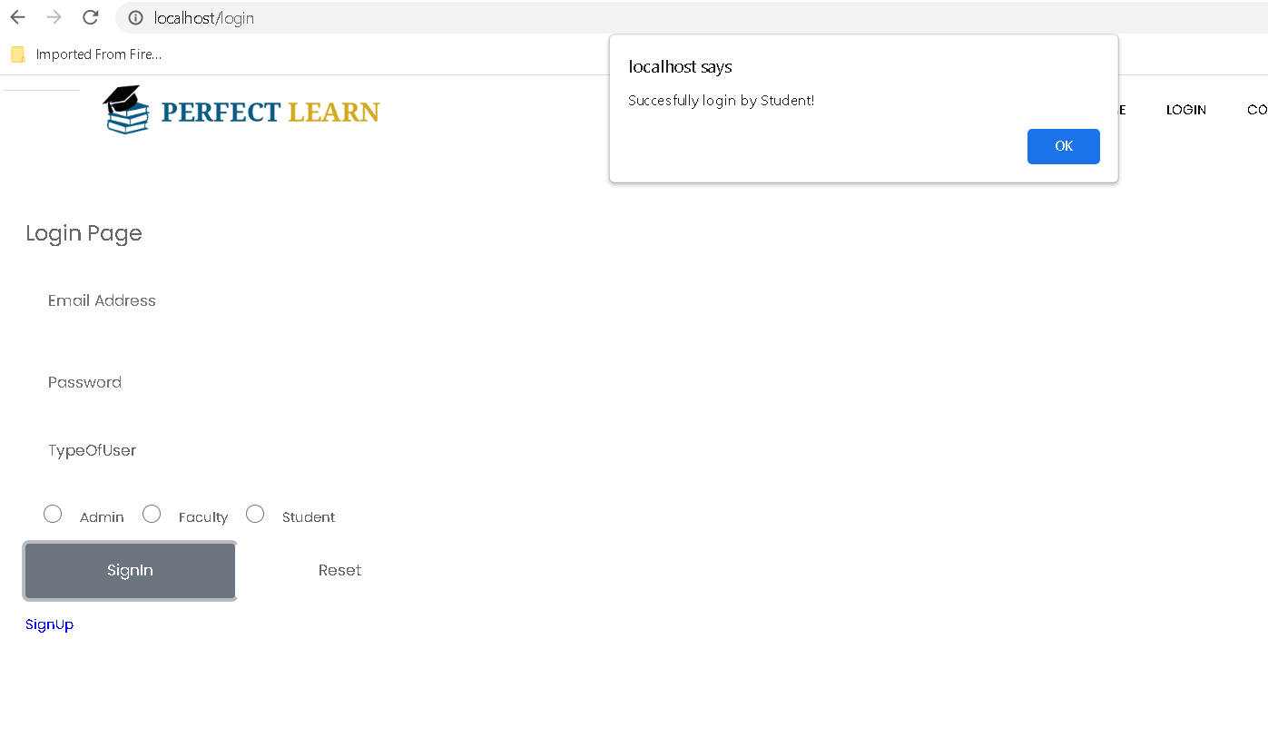
Student login successfully

Slide 51
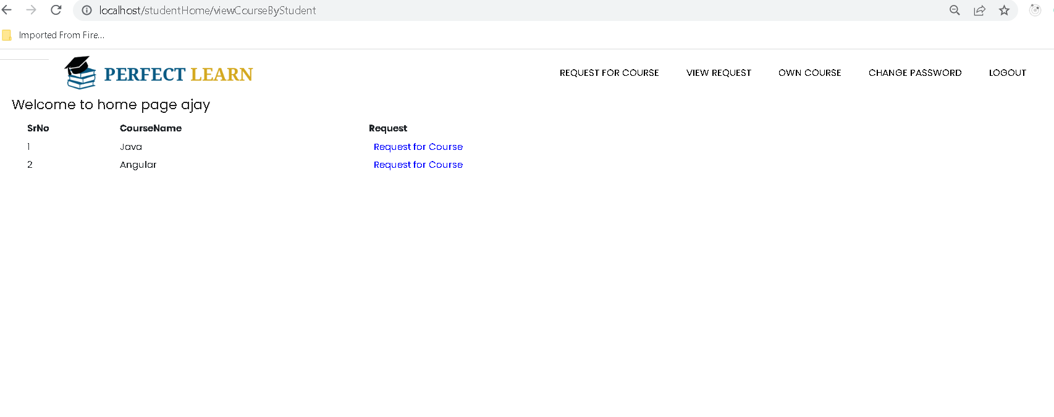
Student request for course

Slide 52
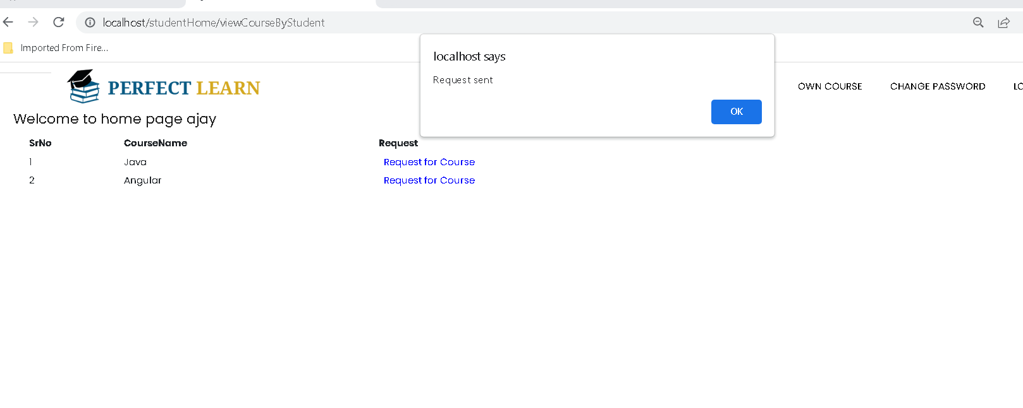
Student request sent

Slide 53
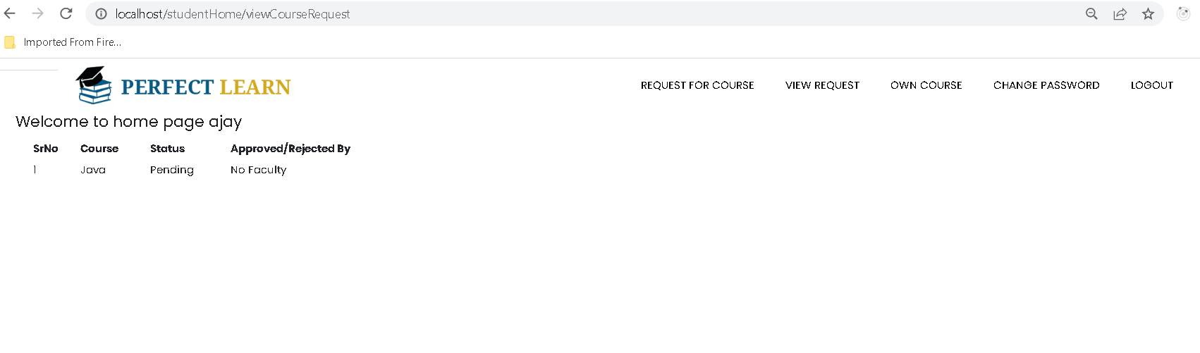
Request status sent by student

Slide 54
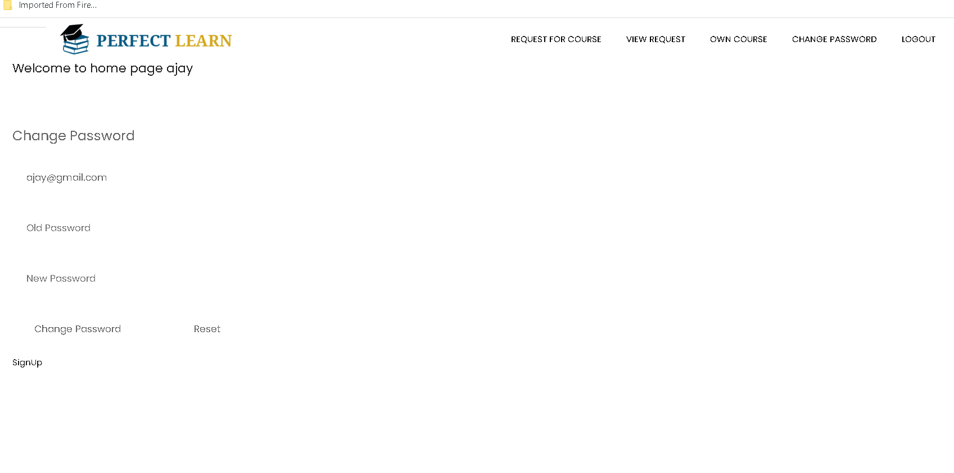
Student change password

Slide 55
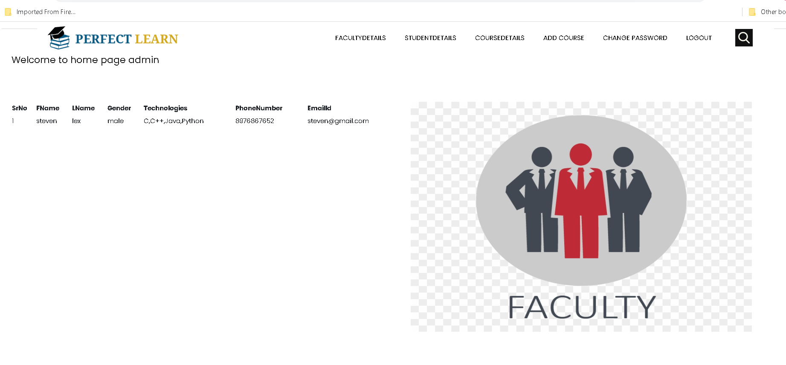
Admin can view all faculty details

Slide 56
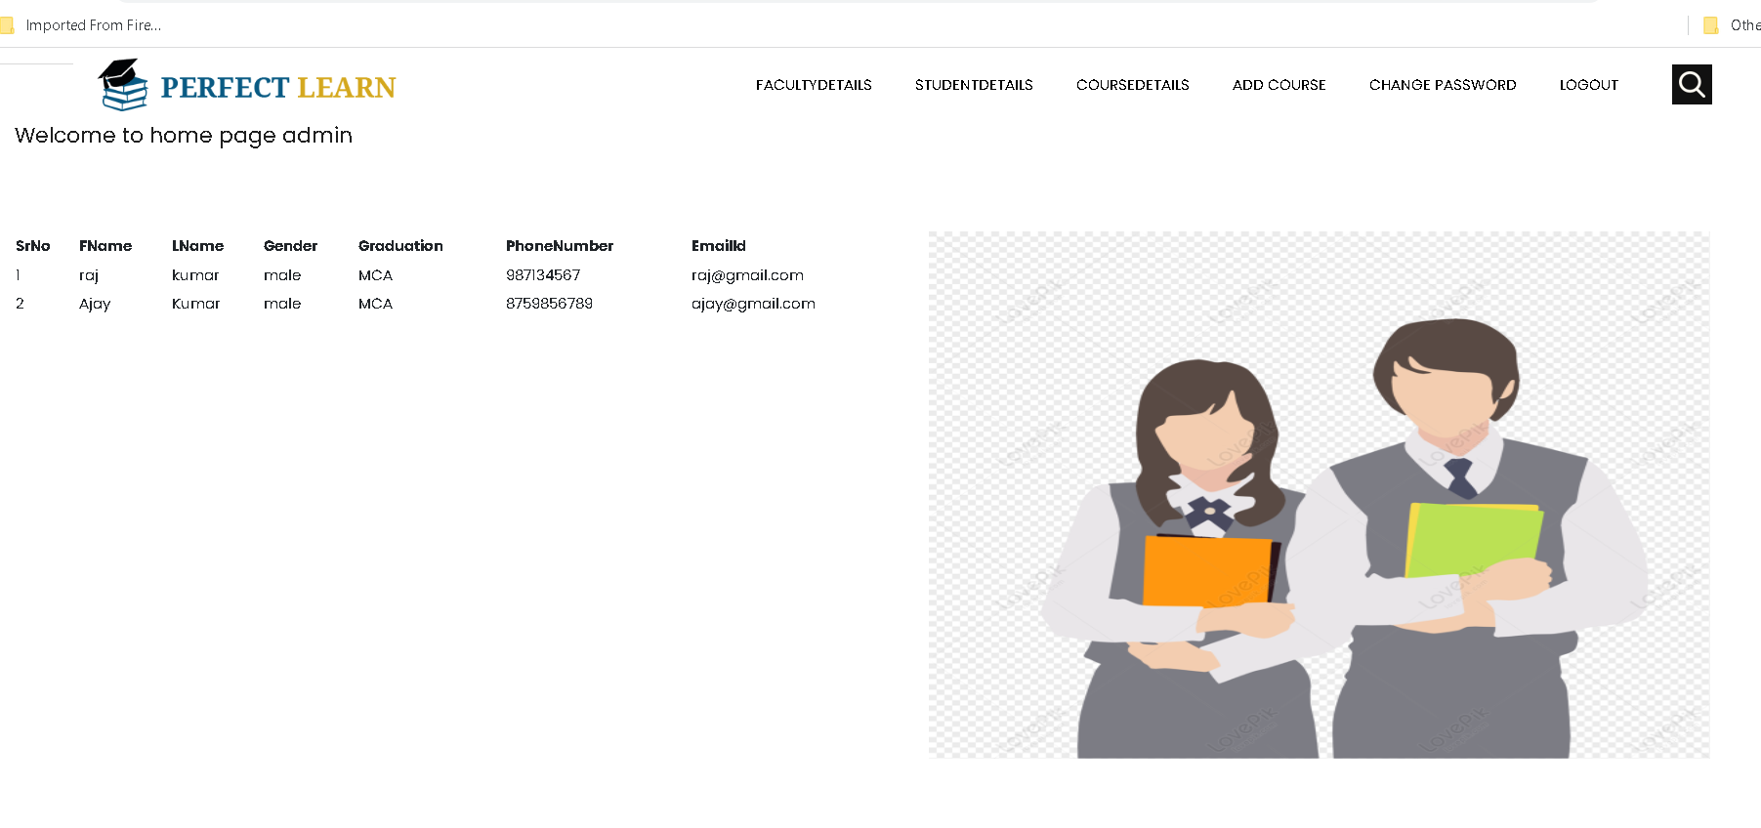
Admin can view all student details

Slide 57

Admin can view all course details

Slide 58

Faculty can view student request

Slide 59

Faculty can approve or reject

Slide 60

After approved student can view status

Slide 61

Student can view the course

Slide 62

To stop all container using command as
sudo docker-compose down

